Slide 1
Types of Registers
BSCS

Slide 2
Memory locations are locations of external main memory (RAM). While, register are the fastest location inside the microprocessor (ax, bx, cx, dx, ss, cs, si, and di etc)
Mnemonic is a symbolic representation e.g. AX, BX, ADD, MOV, DB and DW etc. While, opcode is a mnemonic that performs the operation e.g. MOV, ADD, SUB, PUSH etc

Slide 3
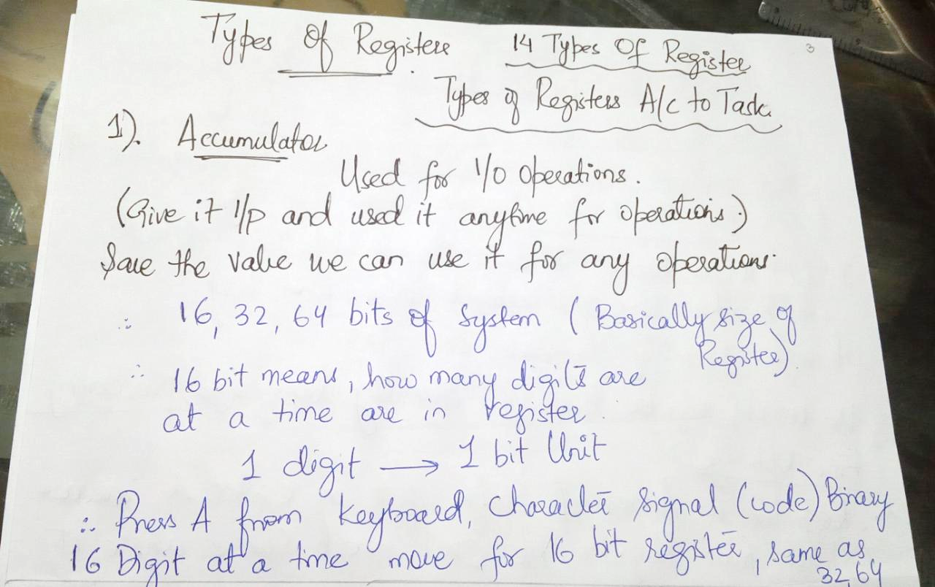

Slide 4
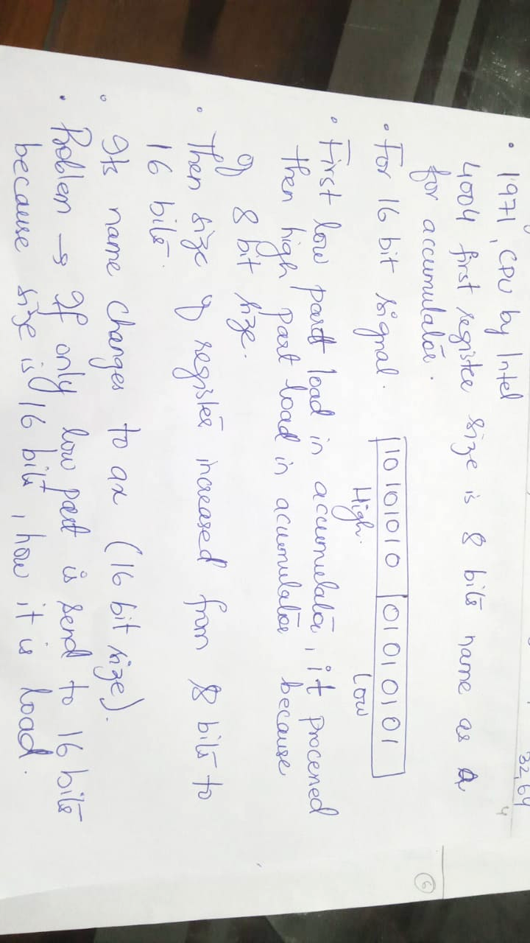

Slide 5
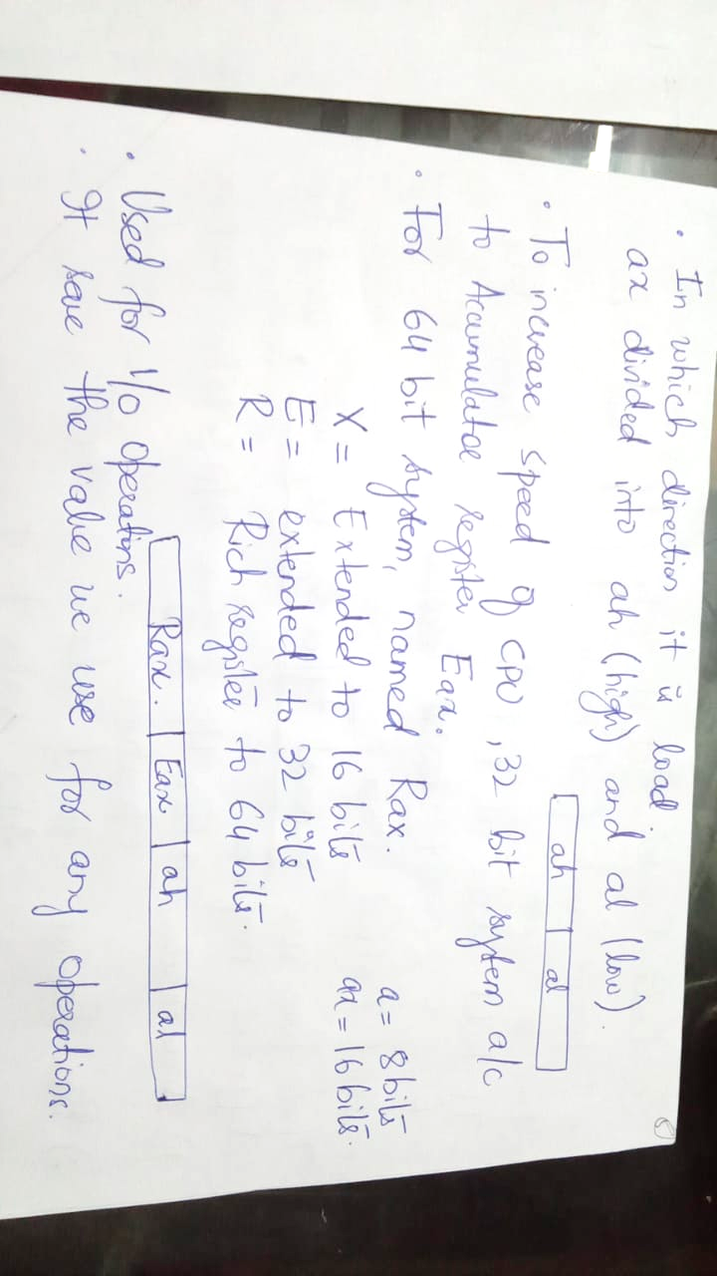

Slide 6
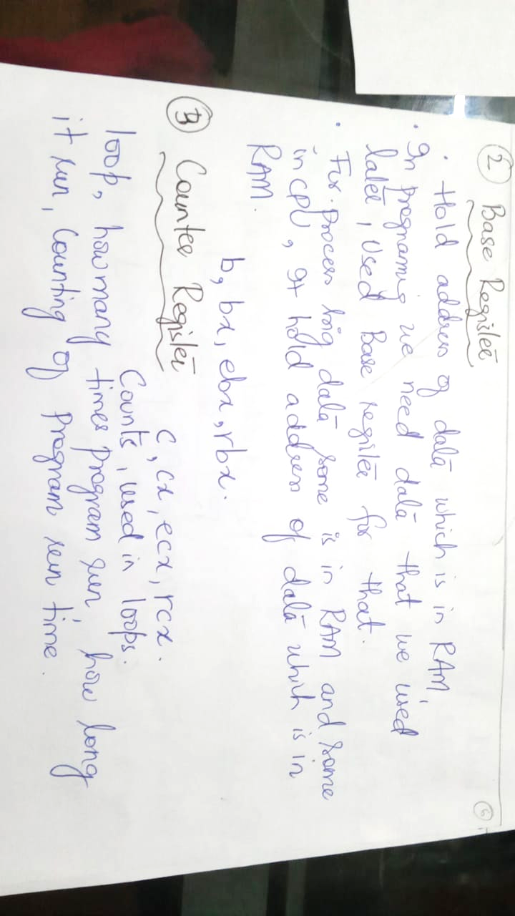

Slide 7


Slide 8
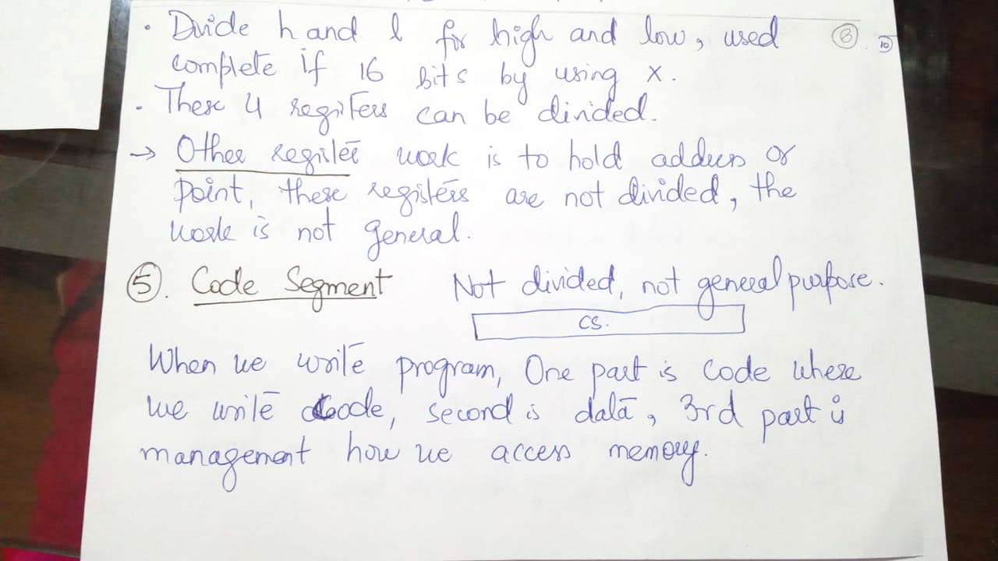

Slide 9
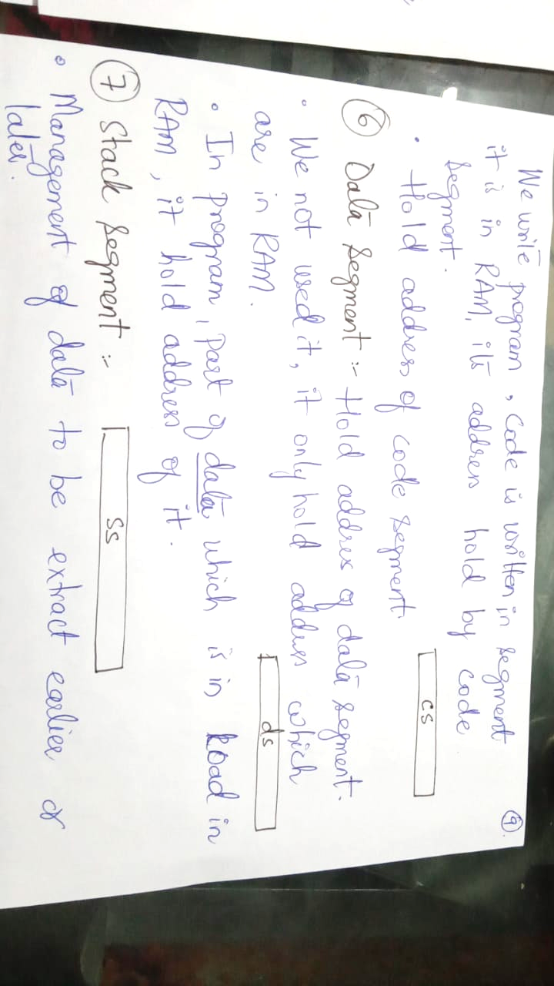

Slide 10
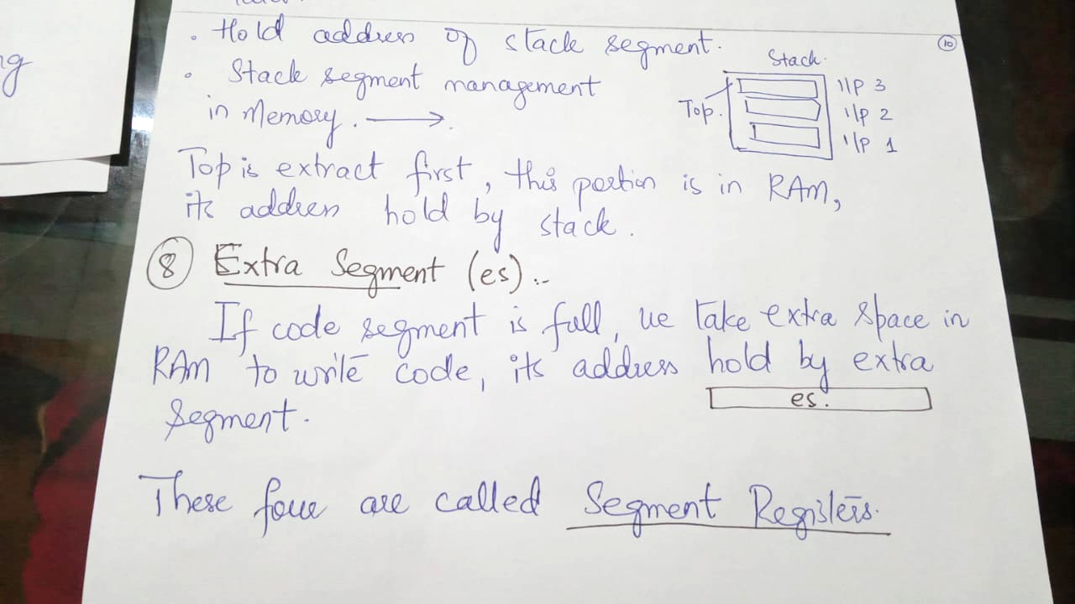

Slide 11
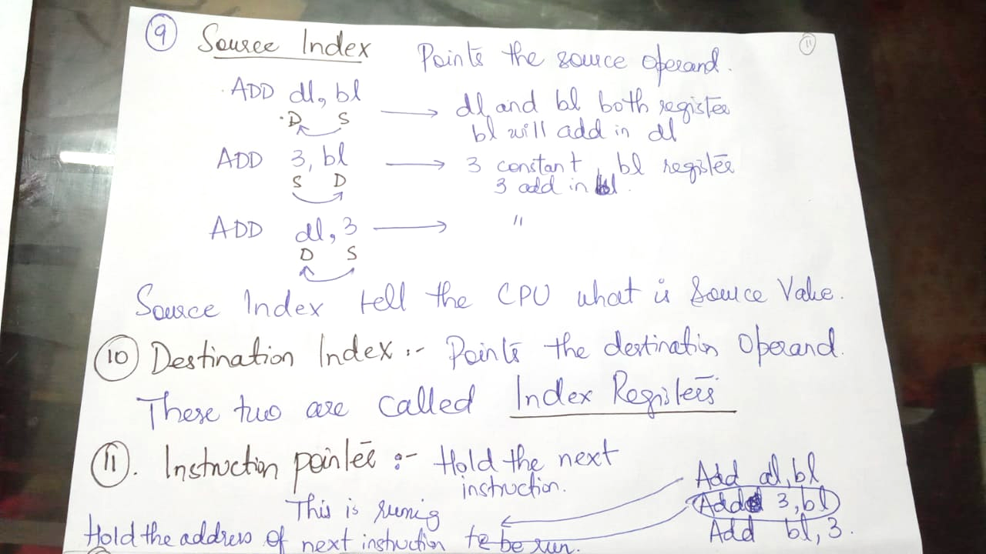

Slide 12
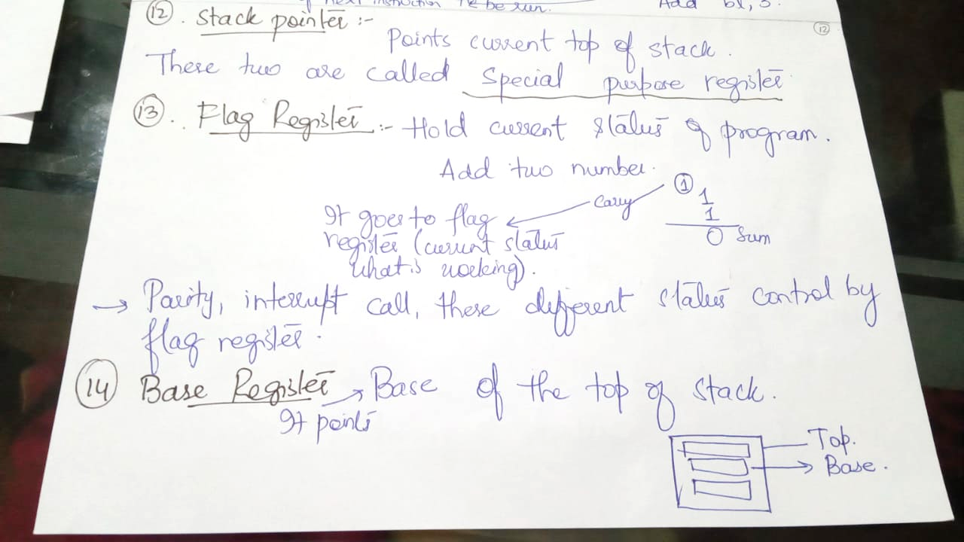

Slide 13


Slide 14


Slide 15


Slide 16
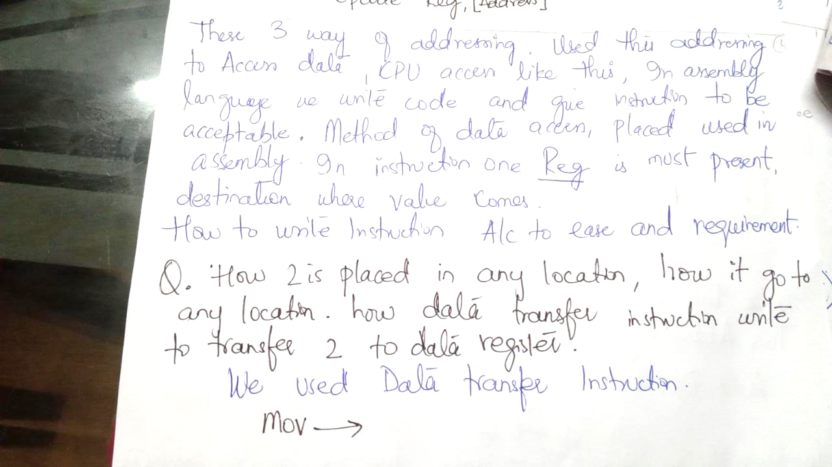

Slide 17


Slide 18


Slide 19
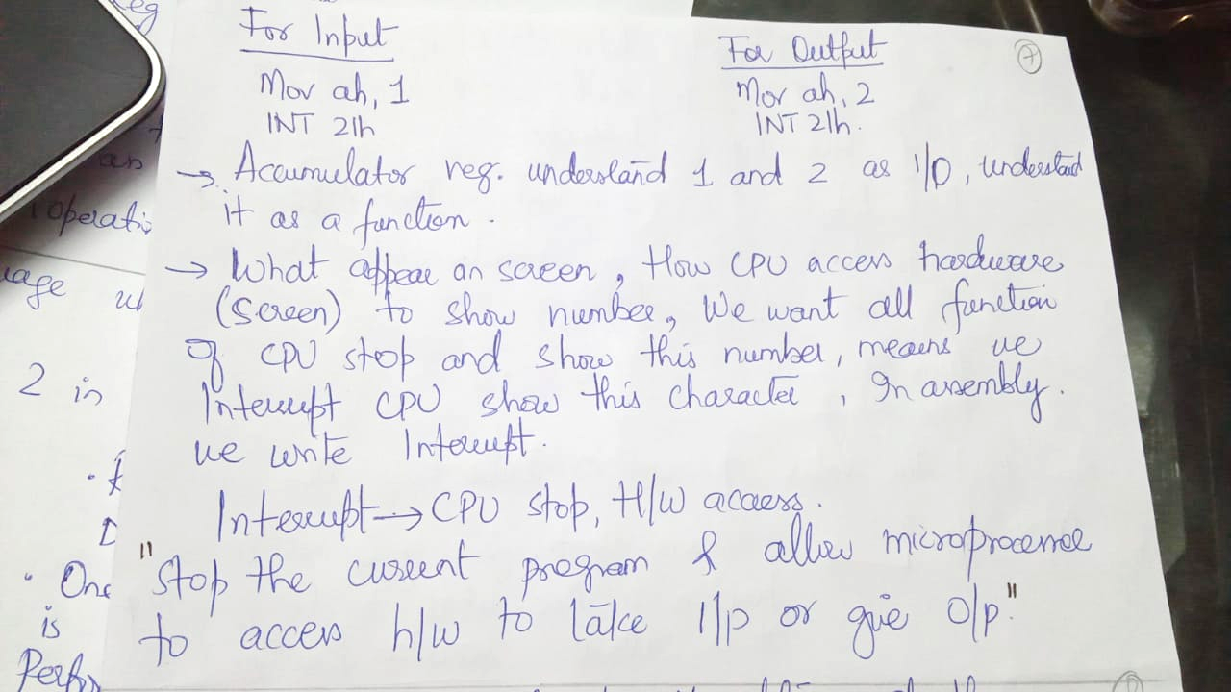

Slide 20


Slide 21
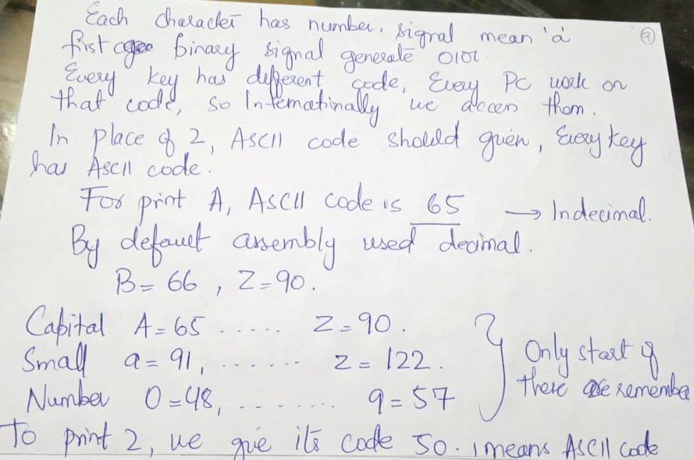

Slide 22
